Slide 1
Puzzlebot Gazebo Simulator
Instructions manual

Slide 2
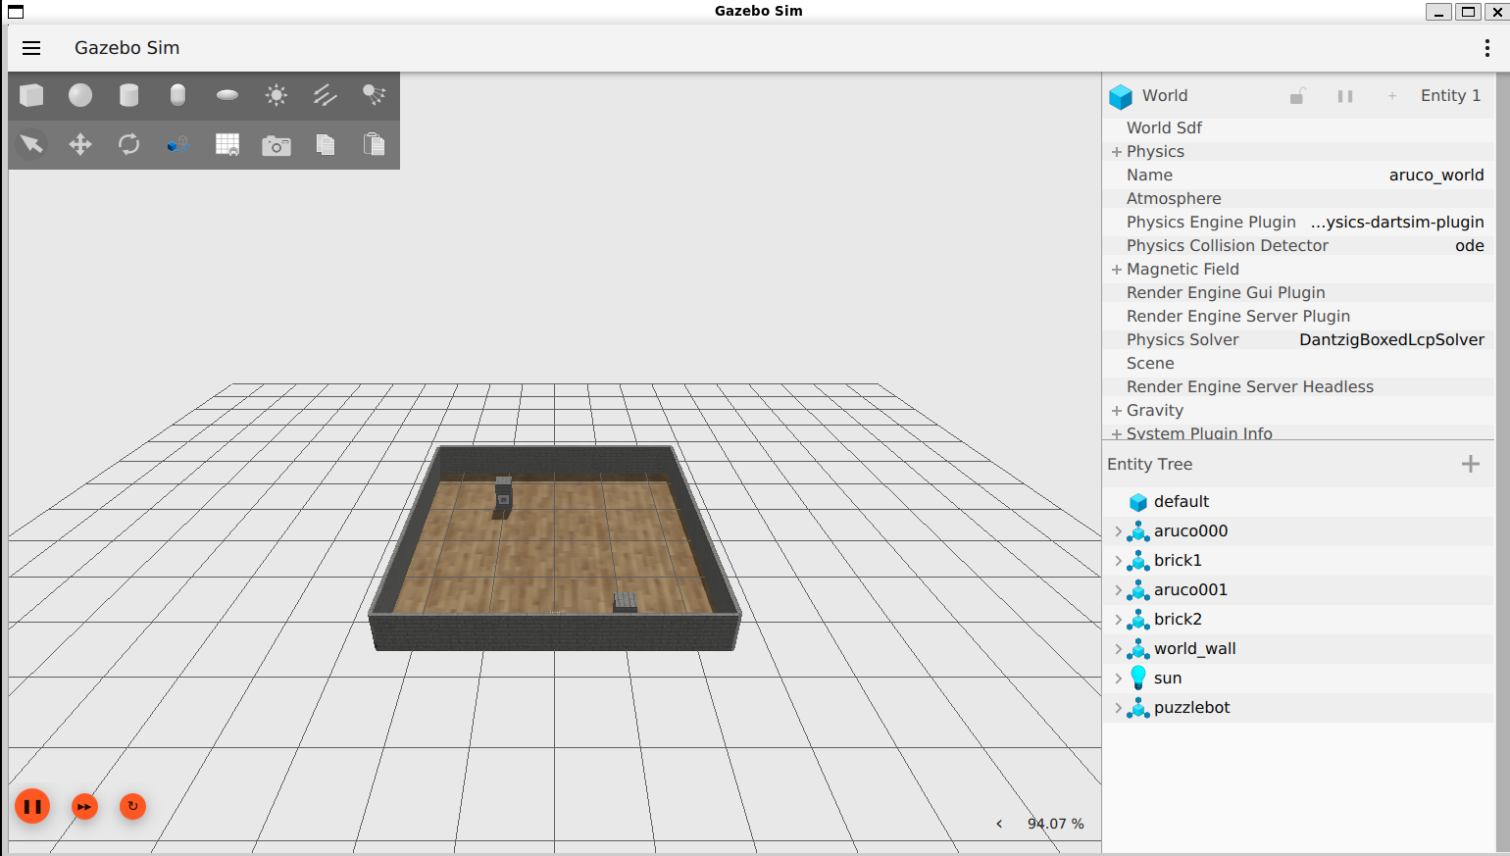
Gazebo simulation
Initialising the simulation
Download the ROS packages to your workspace source folder (e.g., ros2_ws/src)
Build and source the packages
Run the Puzzlebot gazebo simulator using the following command
The following screen should appear
If having rendering issues using a VM or WSL type the following command. More information here
puzzlebot_gazebo
puzzlebot_description
$ cd ~/ros2_ws
$ colcon build
$ source install/setup.bash
$ ros2 launch puzzlebot_gazebo bringup_simulation_launch.py
$ export LIBGL_ALWAYS_SOFTWARE=1

Slide 3
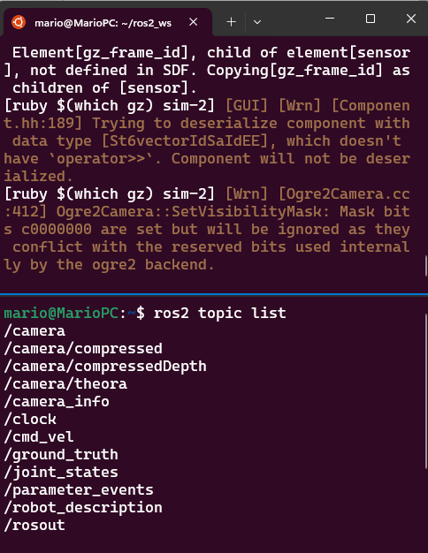
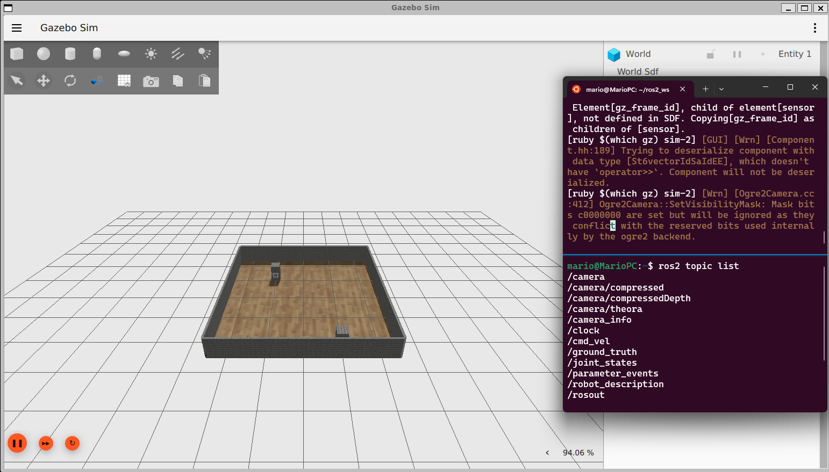
Gazebo simulation
Initialising the simulation
Open another terminal
Verify the topics generated by the simulator using the following command
The following list of topics should appear
$ ros2 topic list

Slide 4
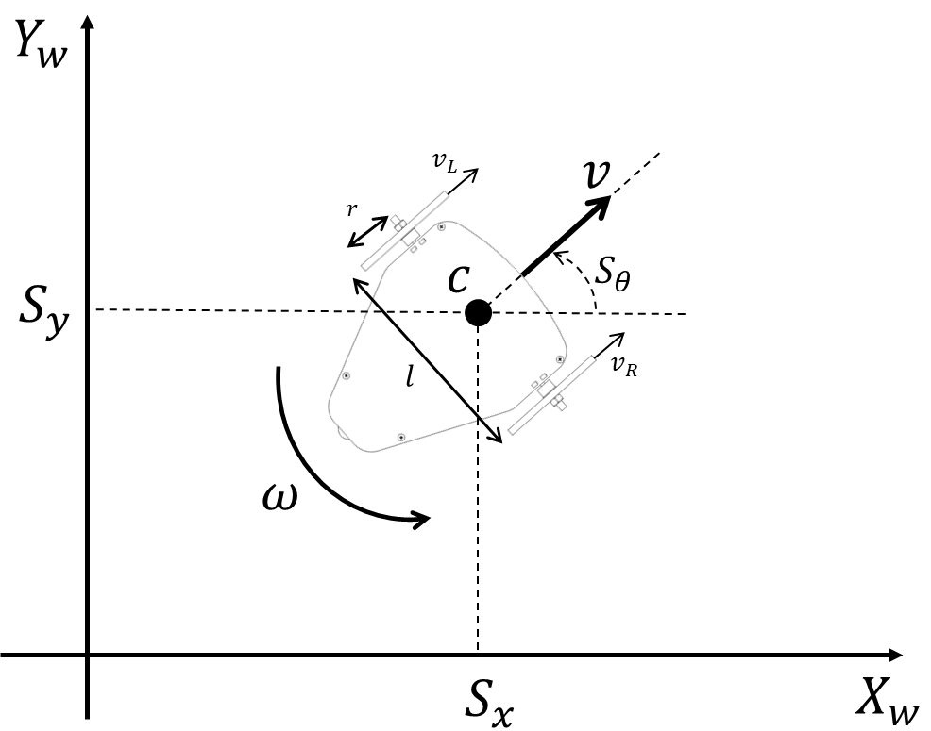

Gazebo simulation
Running the simulation
Sending velocity commands to the robot is done using the following topic
The message to be used is a geometry_msg/Twist (more information here)
The robot’s linear velocity $v$ and angular velocity $ω$ must be set in the linear.x and angular.z sections of the message (ROS convention for differential drive robots).
/cmd_vel
Topic: /cmd_vel
Message: geometry_msgs/Twist
"linear:
x: linear_velocity (v)
y: 0.0
z: 0.0
angular:
x: 0.0
y: 0.0
z: angular_velocity (omega)"

Slide 5
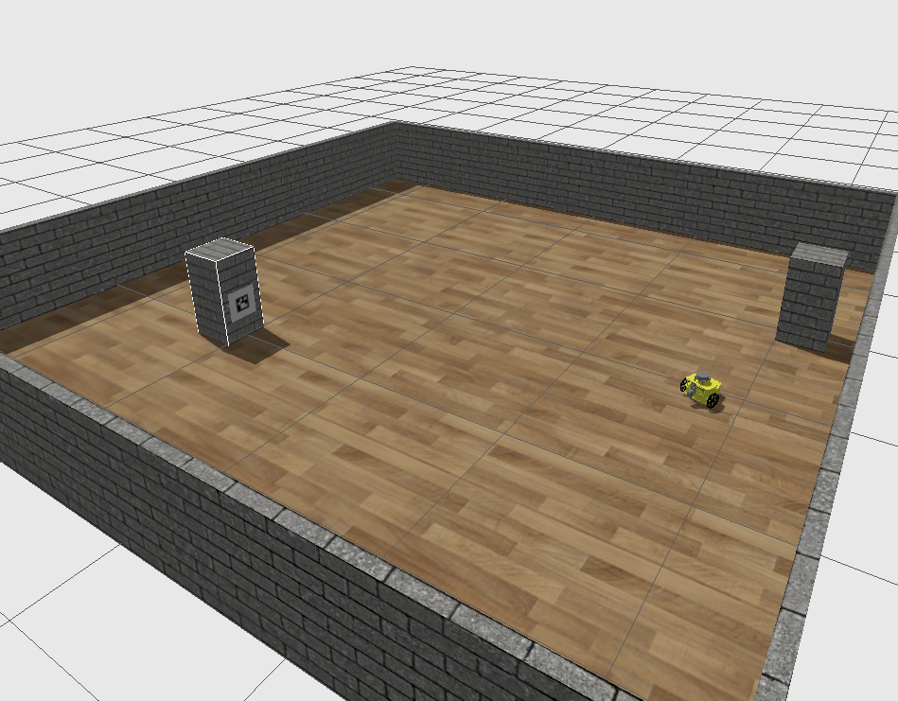
Gazebo simulation
Running the simulation
To publish a message to the gazebo-simulated robot from the terminal can be done as follows.
The previous command will make the robot to run in a circle.
$ ros2 topic pub /cmd_vel geometry_msgs/msg/Twist "linear:
x: 0.3
y: 0.0
z: 0.0
angular:
x: 0.0
y: 0.0
z: 0.3"

Slide 6
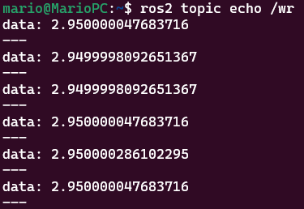
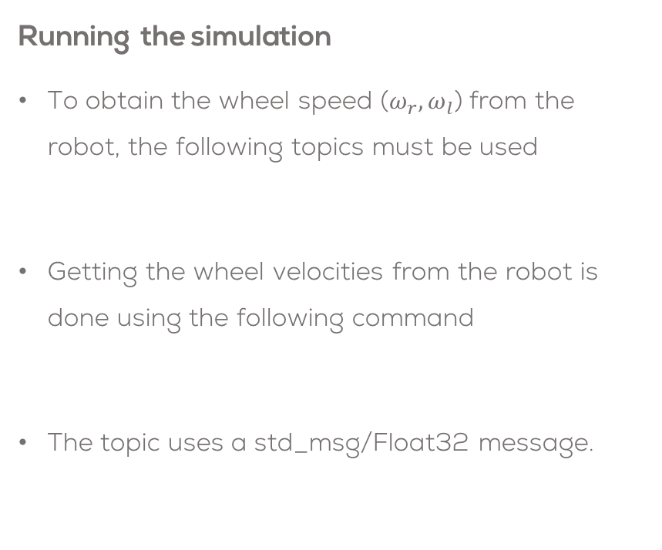
Gazebo simulation
Running the simulation
To obtain the wheel speed ($ω_{r}, ω_{l}$) from the robot, the following topics must be used
Getting the wheel velocities from the robot is done using the following command
The topic uses a std_msg/Float32 message.
/VelocityEncR
/VelocityEncL
$ ros2 topic echo /VelocityEncR
Topic: /VelocityEncR
Message: std_msgs/Float32

Slide 7
Robot Teleoperation
Install the teleoperation package
Run the gazebo simulator as described before
In another terminal, run the teleoperation node as follows
Control the robot using the keyboard (i, j, l, k) as described on the terminal.
sudo apt-get install ros-humble-teleop-twist-keyboard
$ ros2 launch puzzlebot_gazebo bringup_simulation_launch.py
ros2 run teleop_twist_keyboard teleop_twist_keyboard

Slide 8
Puzzlebot Gazebo Simulator
Advanced Features

Slide 9
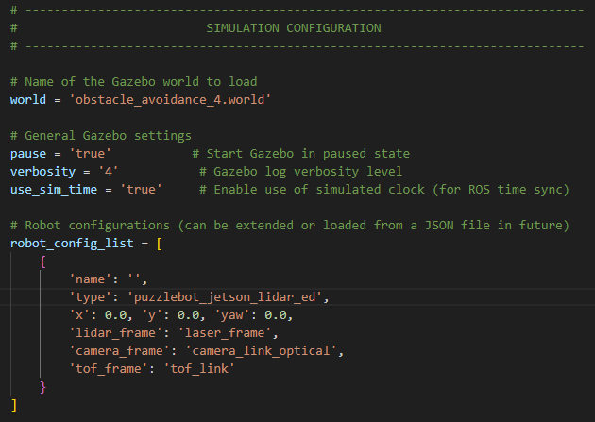
Simulator Configuration
Simulation Configuration
The simulator can be configured from the file “bringup_simulation_launch.py”
The configuration is defined in the section “SIMULATION CONFIGURATION”
In this section, the user can configure the world to be used, the robot type and the position of the robot, as well as the frames for each sensor (if applicable).

Slide 10
Changing the environment
Puzzlebot Environments
MCR2 provide different environments for the Puzzlebot to interact with.
The available environments are in the package “puzzlebot_gazebo” in the folder “worlds”.
The world description files are the ones ending in “.world” or “.sdf”.
Changing the environment
Open the file “bringup_simulation_launch.py” in the “puzzlebot_gazebo” package.
Line 15 controls the environment to be used.
Change the value of the name in the default value by the name of the world you want to use.
~/puzzlebot_gazebo/launch/bringup_simulation_launch.py
world = 'world_aruco_mip.sdf'
empty.world
obstacle_avoidance_1.world
obstacle_avoidance_2.world
obstacle_avoidance_3.world
obstacle_avoidance_4.world
office.world
puzzlebot_arena.world
puzzlebot_arena_markers.world
puzzlebot_world.world

Slide 11
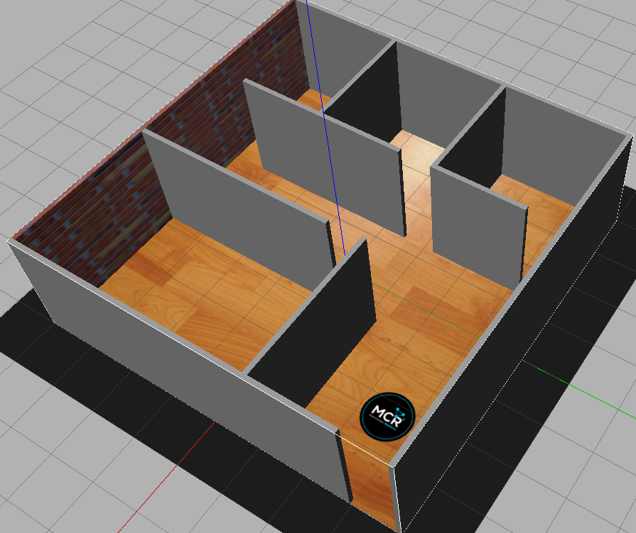
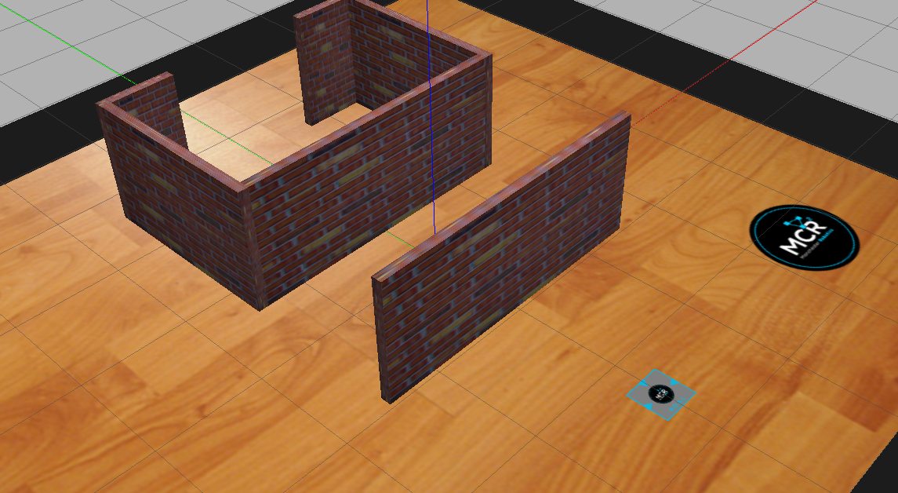
Changing the environment
Save the file
Follow the instructions in the previous section to initialise the Gazebo simulator.
The following models should appear on the screen.

Slide 12
Simulator Configuration
General Gazebo Settings
The Gazebo general settings can be also be configured.
Open the file “bringup_simulation_launch.py” in the “puzzlebot_gazebo” package.
Lines 17-20 control some basic settings such as pause, verbosity and sim_time.
Pause (true/false): sets the simulation to start paused or running from the start.
Verbosity [0-4]: Sets the simulator's verbosity level (log description) 4 prints more information about the simulator on the terminal.
use_sim_time (true/false): Enables the use of Gazebo clock (simulated clock). The clock is published on the topic “/clock”
If using it, ensure the parameter “use_sim_time” of each node that uses time from Gazebo is enabled.
Set to false if using Gazebo and a real robot simultaneously.
~/puzzlebot_gazebo/launch/bringup_simulation_launch.py
# General Gazebo settings
pause = 'true' # Start Gazebo in paused state
verbosity = '4' # Gazebo log verbosity level
use_sim_time = 'true’ # Enable use of simulated clock

Slide 13
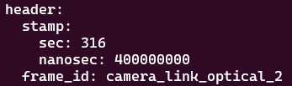
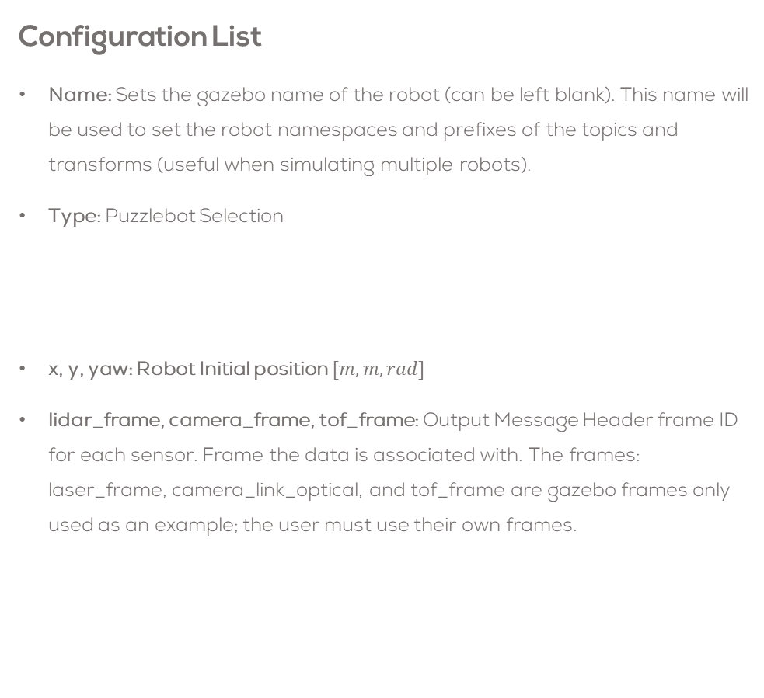
Changing Puzzlebot model
Configuration List
Name: Sets the gazebo name of the robot (can be left blank). This name will be used to set the robot namespaces and prefixes of the topics and transforms (useful when simulating multiple robots).
Type: Puzzlebot Selection
x, y, yaw: Robot Initial position $[m,m,rad]$
lidar_frame, camera_frame, tof_frame: Output Message Header frame ID for each sensor. Frame the data is associated with. The frames: laser_frame, camera_link_optical, and tof_frame are gazebo frames only used as an example; the user must use their own frames.
General Gazebo Settings
The Puzzlebot models/entities are configured from a list that contains all the parameters required for each robot.
puzzlebot_hacker_ed
puzzlebot_jetson_ed
puzzlebot_jetson_lidar_ed
robot_config_list = [
{
'name': 'robot1',
'type': 'puzzlebot_jetson_lidar_ed',
'x': 0.0, 'y': 0.0, 'yaw': 0.0,
'lidar_frame': 'laser_frame',
'camera_frame': 'camera_link_optical',
'tof_frame': 'tof_link'
}
]

Slide 14

Changing Puzzlebot model
Save the file
Follow the instructions in the previous section to initialise the Gazebo simulator.
The following models should appear on the screen.

Slide 15

Changing Puzzlebot model
Each robot contains different topics according to the sensors and the information published.
Use a “ros2 topic list” command to view the topics of each robot

Slide 16
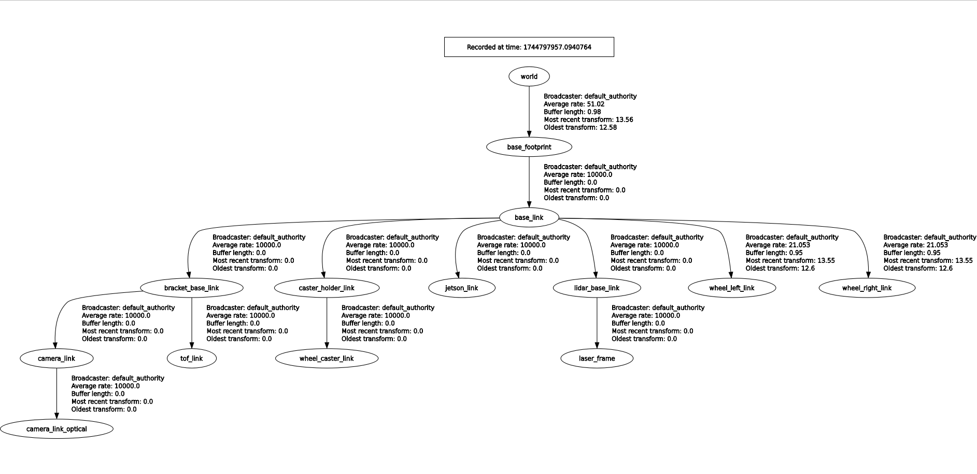
Gazebo simulation
Running the simulation
The simulator outputs a transform tree for the robot that can be used for visualisation in RVIZ.
The transform tree root is the “world” frame.
The robot frames will change depending on the robot type, i.e., Puzzlebot_hacker_ed, Puzzlebot_jetson_edition, Puzzlebot_jetson_lidar_ed, due to the frames of the sensors.

